Slide 1
BUILD TOOLCHAIN CMAKE CONAN TRAINING

Slide 2
Prerequisites for training repo
Compilation and linking process
What is Cmake
Modern project structure
Cmake basics
Cmake’S base concept
Cmake commands
Cmake Variables
Aliases and Namespace
Cmake Installation
Cmake Finding Things
Conan
Conan Package Basics
Conan Package Creation
Conan Install

Slide 3
PREREQUISITES for TRAINING REPO

Slide 4
ITC2, Repository and VSCode
PREREQUISITES for TRAINING REPO
Make sure you have VSCode installed https://code.visualstudio.com/
Make sure you have ITC2 installed https://inside-docupedia.bosch.com/confluence/pages/viewpage.action?pageId=1581813052
Update ITC2 and make sure you have at least version 1.9.1-1
C:\TCC\itc2\itc2.exe RA6:0.2.0 --self-update
To start vscode using the environment provided by itc2 RA6:0.2.0 run the following command:
C:\TCC\itc2\itc2.exe run RA6:0.2.0 -- code
Clone the following repo: https://sourcecode.socialcoding.bosch.com/users/sdo2lr/repos/cmake_training/browse
Branch: cmake-training-V1

Slide 5
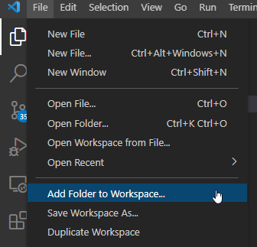
VSCode – How to set workspace to exercise directory
PREREQUISITES for TRAINING REPO
For every exercise you need to add the exercise folder to your workspace
This is to help you easily execute all exercises
Remind to do that whenever you start a new exercise

Slide 6
Compilation and Linking Process

Slide 7
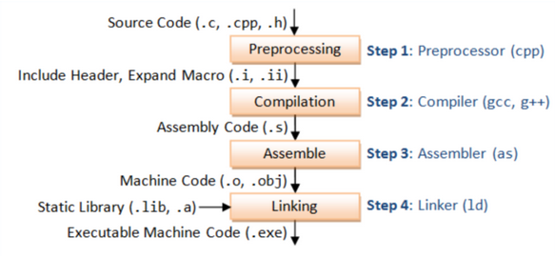
Compilation and Linker process
Compilation and Linker process
Notes:
Preprocessing: The preprocessor reads commands starting with # by removing comments, expanded included files and expanding macros.
If a header file such as #include <stdio.h> is included, it will look for the stdio.h file and copy the header file into the source code file.
The preprocessor also generates macro code and replaces symbolic constants defined using #define with their values. If you use < > to enclose the file, you will find the file in the system’s include directory. If you use “” to enclose the file, you will find the file in the current directory.
Compiler: In compiling, a compiler is a computer program that translates computer code written in one programming languge(the source language) into another language (the target language). The name “compiler” is primarily used for programs that translate source code from a high-level programming language (e.g., assembly language, object code, or machine code) to create an executable program.
Pre-processed code enters the compiler. The compiler generates assembly code using mnemonics. The assembly code is a code the assembler can read.
Assembler: The assembly process converts the previous assembly code into machine code. In this phase the filename.s is taken as input and turned into filename.o by assembler. This file contain machine level instructions. At this phase, only existing code is converted into machine language, the function calls like printf() are not resolved.
Linking: The linking process links multiple target files and required library files (. So, etc.) to the final executable file。 At this stage, the Linker is able to take the machine language and link it to any references the code may call from the libraries referenced in the code and available to the linker. The Library, in this case, contains function code. Linker will decide which functions from the library are necessary and useful to covert the code into an executable file.

Slide 8
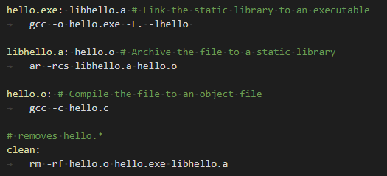
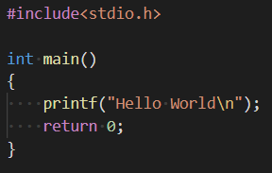
A basic Makefile
Compilation and Linker process
Makefile
Syntax for Makefile
targets: prerequisites
<commands>
-c: Compile the source code into an object file
-o: Create an executable
-L: Path where a library can be found
-l: Name of the library to be linked
-I: Path to include files to be used
-D: Set a Preprocessor defines
Hello.c

Slide 9
A basic Makefile
Compilation and Linker process
.o files are objects. They are the output of the compiler and input to the linker
.a files are archives. They are groups of objects or static libraries and are input into the linker.
-o: specifies the output executable filename
hello.exe: name of the executable
-L is the path to the directories containing the libraries
-lhello: -l name of the library you want to link to
Makefile
AR: Archive-maintaining program
-r: replaces or adds file to archive. If archive does not exist, ar creates it and prints a message
-c: suppresses the message ar normally prints when it creates a new archive file.
-s: regenerates the symbol table regardless of whether the command modifies the archive
libhello.a: target file name
-c: Compile the source code into an object file

Slide 10
Exercise – Hello World
Compilation and Linker process
Checkout training repository https://sourcecode.socialcoding.bosch.com/users/sdo2lr/repos/cmake_training/browse
Inspect exercise HelloWorld
Explain the content of the compile_commands.json file (Real world example from Gen5)

Slide 11
Writing Makefiles
Compilation and Linker process
If we have to write such a Makefile for a huge project, that doesn’t scale !
You need to maintain the Makefile for all dependencies
We don’t want to do that for large projects
We don’t want to write such files for different build systems
We don’t want to handle the dependencies and link order of the libraries in such a complicated way
→ CMake will help us ☺

Slide 12
WHAT is CMAKE ?

Slide 13
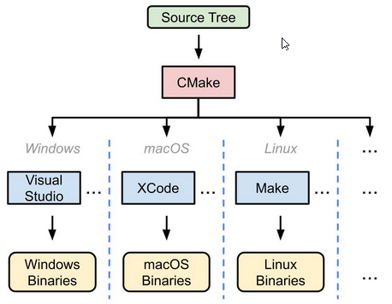
What is CMake ?
What is CMake ?
CMake is an open-source, cross-platform family of tools designed to build, test and package software
CMake is used to control the software compilation process using simple platform and compiler independent configuration files and generate native Makefiles and workspaces that can be used in the compiler environment of your choice
Notes:
Cmake is not a buildsystem, it’s a cross-platform C++ build generator

Slide 14
Modern Project Structure

Slide 15
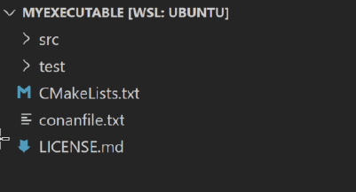
Executable
Modern Project Structure
./CMakeLists.txt
Entry point for development
Enables all development process specific features (i.e. compilation warnings)
Simple project wrapper
src and test subdirectories added with add_subdirectory()
./conanfile.txt
List of project's dependencies and their configuration
Provides a build system's specific generator
Notes:
CMakeLists.txt is needed for CMake as an entry point. Conanfile is the entry file for the package manager Conan. We will explain the content of those file in this training.

Slide 16
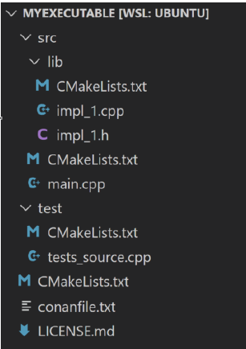
Executable
Modern Project Structure
./src/lib
Defines a library target with most of the project's implementation
Used as an input for both the executable and unit tests
./src/CMakeLists.txt
Standalone CMake file
lib subdirectory added with add_subdirectory()
Defines the final executable

Slide 17
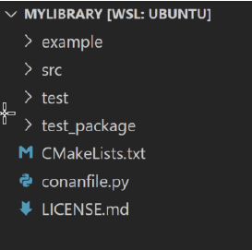
Library
Modern Project Structure
./conanfile.py
List of project's dependencies and their configuration
Provides a build system's specific generator
Provides a full recipe to build, package, and reuse the library with Conan

Slide 18
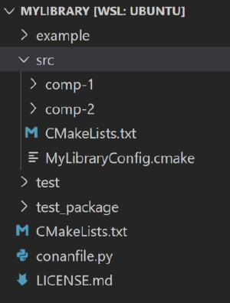
Library
Modern Project Structure
./src/CMakeLists.txt
Standalone CMake file
Entry point for customers
Component's subdirectories added with add_subdirectory()
Doesn't change development related flags!
./src/MyLibraryConfig.cmake
CMake's project configuration needed for CMake installation process
Provides the dependency information to CMake

Slide 19
CMAKE BASICS

Slide 20
Buildsystem
CMake Basics
A buildsystem describes how to build a project's executables and libraries from its source code using a build tool to automate the process. In order to avoid maintaining multiple such buildsystems, a project may specify its buildsystem abstractly using files written in the CMake language. From these files CMake generates a preferred buildsystem locally for each user through a backend called a generator
To generate a buildsystem with CMake, the following must be selected:
Source Tree
The top-level directory containing source files provided by the project. The project specifies its buildsystem using files, starting with a top-level file named CMakeLists.txt
Build Tree
The top-level directory in which buildsystem files and build output artifacts (e.g. executables and libraries) are to be stored. CMake will write a CMakeCache.txt file to identify the directory as a build tree and store persistent information such as buildsystem configuration options
Generator
This chooses the kind of buildsystem to generate

Slide 21
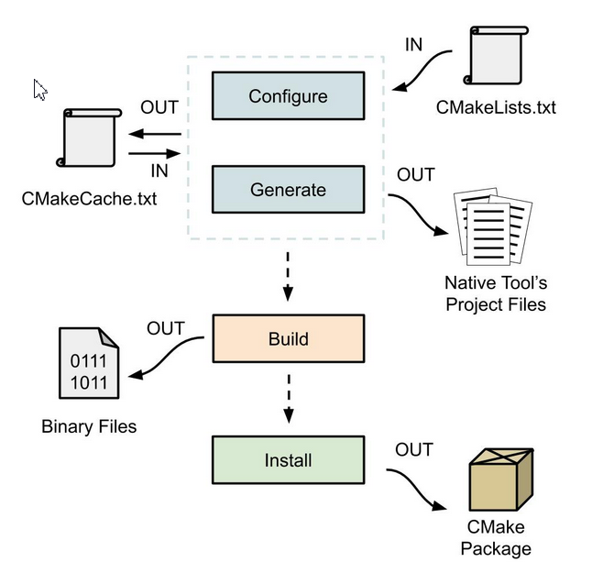
CMake stages
CMake Basics
Notes:
Everything starts with a CMakeLists.txt in the rood folder of your project. This is the entry point for CMake. We will see later how such a file looks like.

Slide 22
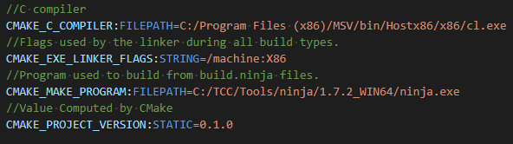
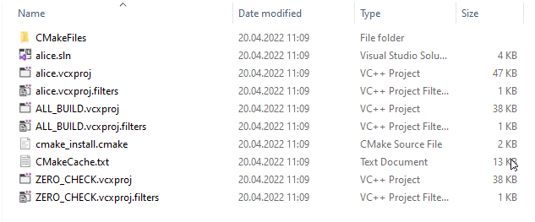

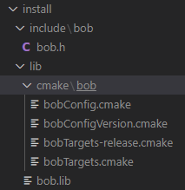
CMake stages
CMake Basics
cmake_minimum_required(VERSION 3.2)
project(MyApp CXX)
add_executable(MyExe main.cpp)
Notes:
Everything starts with a CMakeLists.txt in the rood folder of your project. This is the entry point for CMake. We will see later how such a file looks like.

Slide 23
CMake stages
CMake Basics
Configure
Configure stage will compile the CMake script CMakeLists.txt and update cache variables in CMakeCache.txt file.
Generation
Generation stage happens right after configure, without a choice, and it will generate project files for each defined target based on the configuration stored in CMakeLists.txt.

Slide 24
CMake stages
CMake Basics
Build
Build stage will build the project, like we would build it in Visual Studio IDE, based on the generated configuration files.
The selected Generator (another name for the Native Build Tool, that declares compiler and IDE environment) is used to build the configured project in the Build Directory
Build stage with CMake is optional since, once the generation stage is completed, we will be able to open the solution with our IDE and build it from there

Slide 25
CMake stages
CMake Basics
Install
Install stage will prepare our projects to be easily reused in other CMake driven code bases
Using more technical terms, it will create CMake packages out of our code so we will be able to include it somewhere else by first packing it and then using find_package(..) function
This facilitates the inclusion of external project dependencies, and it makes the CMake scripts much less verbose
Install stage is completely optional and we could have stopped at the build stage

Slide 26
CMake commands
CMake Basics
We are now going to check how to call those steps via command line ☺

Slide 27
Overview basic CMake commands
CMake Basics
Generate a project buildsystem
cmake [<options>] <path-to-source>
cmake [<options>] <path-to-existing-build>
cmake [<options>] -S <path-to-source> -B <path-to-build>
Build a Project
cmake --build <dir> [<options>] [-- <build-tool-options>]
Install a Project
cmake --install <dir> [<options>]
Run a Command-Line Tool
cmake -E <command> [<options>]

Slide 28
Generate a project buildsystem
CMake Basics
cmake [<options>] <path-to-source>
Uses the current working directory as the build tree, and <path-to-source> as the source tree
The specified path may be absolute or relative to the current working directory
The source tree must contain a CMakeLists.txt file and must not contain a CMakeCache.txt file because the latter identifies an existing build tree
mkdir build
cd build
cmake ../src

Slide 29
Generate a project buildsystem
CMake Basics
cmake [<options>] <path-to-existing-build>
Uses <path-to-existing-build> as the build tree
Loads the path to the source tree from its CMakeCache.txt file, which must have already been generated by a previous run of CMake
The specified path may be absolute or relative to the current working directory
cd build
cmake .

Slide 30
Generate a project buildsystem
CMake Basics
cmake [<options>] -S <path-to-source> -B <path-to-build>
Uses <path-to-build> as the build tree and <path-to-source> as the source tree
The specified paths may be absolute or relative to the current working directory
The source tree must contain a CMakeLists.txt file. The build tree will be created automatically if it does not already exist
cmake -S src -B build

Slide 31
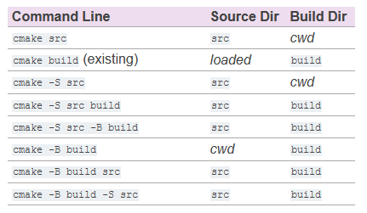
Generate a project buildsystem
CMake Basics
cwd = current working directory

Slide 32
Generate a project buildsystem - Options
CMake Basics
-S <path-to-source>
Path to root directory of the CMake project to build
-B <path-to-build>
Path to directory which CMake will use as the root of build directory. If the directory doesn't already exist CMake will make it
-D <var>:<type>=<value>, -D <var>=<value>
Create or update a CMake CACHE entry
When CMake is first run in an empty build tree, it creates a CMakeCache.txt file and populates it with customizable settings for the project
This option may be used to specify a setting that takes priority over the project's default value
-G <generator-name>
Specify a build system generator
--preset <preset>, --preset=<preset>
Reads a preset from <path-to-source>/CMakePresets.json and <path-to-source>/CMakeUserPresets.json. The preset may specify the generator and the build directory, and a list of variables and other arguments to pass to CMake. The current working directory must contain CMake preset files
The presets are read before all other command line options. The options specified by the preset (variables, generator, etc.) can all be overridden by manually specifying them on the command line

Slide 33
Exercise – Generate a project buildsystem
CMake Basics
Open Exercise “GenerateABuildystem” in VSCode
Generate a project buildsystem via using cmake on the command line for the predefined CMakeLists.txt
In order to work in our environment, you need to use options
-D CMAKE_C_COMPILER=C:/TCC/Tools/mingw64/8.1.0_WIN64/bin/gcc.exe -G Ninja
Play around with the commands
Check which files are created after the generate step and get an impression how they look like

Slide 34
Build a project
CMake Basics
cmake --build <dir> [<options>] [-- <build-tool-options>]
cmake --build --preset <preset> [<options>] [-- <build-tool-options>]
Make provides a command-line signature to build an already-generated project binary tree
--build <dir>
Project binary directory to be built. This is required (unless a preset is specified) and must be first
--preset <preset>, --preset=<preset>
Use a build preset to specify build options. The project binary directory is inferred from the configurePreset key. The current working directory must contain CMake preset files

Slide 35
Exercise – Build a project
CMake Basics
You can stay on folder for exercise “GenerateABuildystem”
Build the project for which you just ran the generation and run the executable to check if the project was build correctly

Slide 36
Install a project
CMake Basics
CMake provides a command-line signature to install an already-generated project binary tree
This may be used after building a project to run installation without using the generated build system or the native build tool
The options are:
--install <dir>
Project binary directory to install. This is required and must be first.
--prefix <prefix>
Override the installation prefix, CMAKE_INSTALL_PREFIX
cmake --install <dir> [<options>]

Slide 37
CMAKE’s BASE CoNCEPT

Slide 38
CMake – Base concepts
CMake Basics
The fundamental objective in CMake is defining a list of Targets and defining Properties in them
Targets
Model the components of our application: an executable is a target; a library is a target.
Our Application is built as a collection of Targets that depend on and use each other
Properties
Targets have Properties:
the source files a target is built from
the compiler options it requires
the libraries it links against …
We also have Global Properties that will be applied by default to every target we define, such as set(CMAKE_CXX_STANDARD 11) that will tell CMake to look for a C++11 compiler version.

Slide 39
CMake – Base concepts
CMake Basics
You can image Cmake Targets as objects
Constructors
add_executable()
add_library()
Member Variables
Target properties
BINARY_DIR
COMPILE_DEFINITIONS
COMPILE_FEATURES
COMPILE_FLAGS
COMPILE_OPTIONS
CXX_STANDARD
…
Member functions
get_target_property()
set_target_properties()
get_property(TARGET)
set_property(TARGET)
target_compile_definitions()
target_compile_features()
target_compile_options()
target_include_directories()
target_link_libraries()
target_sources()

Slide 40
CMake – Base concepts
CMake Basics
Projects
Projects are sets of targets. In Visual Studio they correspond to an entire Solution each
Root Folder
Root Folder is intended as the folder that contains the principal CMake script that will be used to start any operation. This script has the canonical name of CMakeLists.txt
Subdirectories
Subdirectories are special targets representing a root’s subdirectory each, and they can be declared by the command add_subdirectory( SubDirName )
If CMake finds a script inside that subdirectory it will execute it straight away at the moment of the function call. In this second script, all the variables defined before will be available to be queried
This is helpful to decouple CMake script instructions, so each script becomes less verbose and easier to read
A subdirectory is a target itself and can contain CMake scripts that define multiple targets
The main advantage of this mechanic comes when the subdirectory defines some target that we need: we can just link the subdirectory target to our program and CMake will take care of wiring everything up

Slide 41
CMake – Base concepts
CMake Basics
Packages
are mostly used to add project dependencies, in the form of Imported Targets and/or script variables related to that dependency.
Packages can be:
Config-file Packages are the ones that were generated with an install operation inside our solution’s source tree. That means the source tree includes all the source files of such dependency. Each of them provides a configuration file used when the package gets added.
Find-module Packages are modules with a set of rules to find the required bits of a dependency, when the required headers and libraries are located outside the current source tree.

Slide 42
A minimal project
CMake Basics
CMakeLists.txt is CMake's "project" file
Should be at the top of the source tree
Provides all CMake logic
sources
targets
building instructions
testing
packaging
other custom tasks
CMake language provides
variables
functions
macros
conditional logic
looping
code comments
and more...
CMakeLists.txt
cmake_minimum_required(VERSION 3.2)
project(MyApp CXX)
add_executable(MyExe main.cpp)

Slide 43
CMAke Commands

Slide 44
CMake commands
CMake commands
Arguments are separated from each other with spaces and may be split across multiple lines
Command names are case insensitive (the following are all equivalent)
A common convention is to use all lowercase for command names
add_executable(MyExe
main.cpp
src1.cpp
src2.cpp
)
add_executable(MyExe main.cpp)
ADD_EXECUTABLE(MyExe main.cpp)
Add_Executable(MyExe main.cpp

Slide 45
cmake_minimum_required() command
CMake commands
cmake_minimum_required(VERSION major.minor[.patch[.tweak]])
Specifies the expected CMake version for a project
It should always be the first line in a CMakeLists.txt file
Ensures that project's requirements are checked and established before anything else
If the file is processed with
an older CMake version -> CMake configuration error
a newer CMake version -> enforces policy setting to match CMake behaviour of the specified version
Modern CMake starts with version 3.2.
Always choose the most recent CMake version that won’t present significant problems for those building the project
cmake_minimum_required(VERSION 3.2)

Slide 46
project() command
CMake commands
project(projectName
[VERSION major[.minor[.patch[.tweak]]]]
[LANGUAGES languageName ...])
Should be provided in every CMake project after cmake_minimum_required() has been called
projectName may only contain letters, numbers, underscores (_) and hyphens (-)
spaces are not permitted → no need to surround project name with quotes
used for the top level of a project with some project generators, as metadata for packaging, documentation, and more
VERSION used to populate some variables and as default package metadata
LANGUAGES defines the programming languages that should be enabled for the project (C, CXX, Fortran, ASM, CUDA, ...) or NONE
LANGUAGES C CXX by default (if not provided)
project(MyApp VERSION 1.0.0 LANGUAGES CXX)

Slide 47
project() command
CMake commands
project(projectName
[VERSION major[.minor[.patch[.tweak]]]]
[LANGUAGES languageName ...])
Checks the compilers for each enabled language
ensures they are able to compile and link successfully
Sets up a number of variables and properties which control the build for the enabled languages
When the compiler and linker checks performed by CMake are successful, their results are cached in the CMakeCache.txt
they do not have to be repeated in subsequent CMake runs
Populates PROJECT_NAME variable with the projectName
project(MyApp VERSION 1.0.0 LANGUAGES CXX)

Slide 48
Bad habits
CMake commands
cmake_minimum_required(VERSION 3.2)
project(MyApp)
add_executable(MyApp main.cpp)
target_link_libraries(MyApp
PRIVATE pthread
)
Works only for the most basic projects
Consider the project name and executable name as being separate, even if initially they start out the same. Choose a target name according to what the target does rather than the project it is part of

Slide 49
add_executable() command
CMake commands
add_executable(targetName source1 [source2 ...])
Creates an executable from a set of source files
Executable can be referred to within the CMake project as targetName
Name may contain letters, numbers, underscores and hyphens
When the project is built, an executable will be created in the build directory with a platform dependent name being based on the targetName
MyApp.exe on Windows
MyApp on Unix-based platforms
the above default executable name can be customized with target properties
add_executable(MyApp main.cpp)

Slide 50
Commenting
CMake commands
cmake_minimum_required(VERSION 3.2)
# We don't use the C++ compiler, so don't let project()
# test for it in case the platform doesn't have one
project(MyApp VERSION 4.7.2 LANGUAGES C)
# Primary tool for this project
add_executable(MainTool
main.c
debug.c # Optimized away for release builds
)
# Helpful diagnostic tool for development and testing
add_executable(TestTool testTool.c)
CMake follows similar commenting conventions as Unix shell scripts
Any line beginning with a # character is treated as a comment
Except within a quoted string, anything a # on a line is also treated as a comment

Slide 51
Exercise – Example application
CMake commands
Add exercise folder “ExampleApp” to your workspace
Add CMakeLists.txt to the top-level directory of ´”ExampleApp”
Specify a minimum CMake version required as 3.20
Name the project as alice, set the version to 0.1.0 and specify C as its programming language
Add an executable for alice in src/alice.c
Configure the project
Build the project
Execute alice.exe and check if it’s working correctly

Slide 52

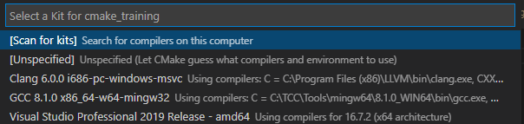

Using VS Code IDE
CMake commands
In order to configure, build and execute the project more easily the IDE settings can be used to realize that
Go to Settings
Set Cmake: Build Directory to:
Set Cmake generator to:
Open the Command Palette (Ctrl+Shift+P) and run CMake: Select a Kit. The extension will automatically scan for kits on your computer and create a list of compilers found on your system.
Select GCC
You will afterwards find something like this bar at the bottom of your VSCode

Slide 53
Exercise – Example application with IDE
CMake commands
Build Alice in Debug and Release mode via IDE
Execute the program in Debug and Release mode

Slide 54
add_library() command
CMake commands
add_library(targetName [STATIC | SHARED | MODULE | OBJECT]
[EXCLUDE_FROM_ALL]
source1 [source2 ...])
Add a library to the project using the specified source files
Libraries in programming languages are collections of prewritten code that users can use to optimize tasks
Difference static / shared: https://www.youtube.com/watch?v=eW5he5uFBNM
Shared
A shared or dynamically linked library
targetName.dll on Windows
libtargetName.dylib on Apple platforms
libtargetName.so on other Unix-like platforms
Static
A static library or archive
targetName.lib on Windows
libtargetName.a on Unix-like platforms

Slide 55
add_library() command
CMake commands
add_library(targetName [STATIC | SHARED | MODULE | OBJECT]
[EXCLUDE_FROM_ALL]
source1 [source2 ...])
Module
A shared library intended to be loaded dynamically at run-time
rather than being linked directly to a library or executable
Used typically for plugins or optional components the user may choose to be loaded or not
No import library is created for the DLL on Windows
Object
A collection of object files that are not combined into a single archive or shared library
From CMake 3.12
object libraries can be used with target_link_libraries()
as the target being added to (i.e. the first argument to the command)
as one of the libraries being added
their transitive nature is more restricted to prevent object files from being added multiple times to consuming targets
only added to a target that links directly to the object library, not transitively beyond that

Slide 56
add_library() command
CMake commands
add_library(targetName INTERFACE
[EXCLUDE_FROM_ALL]
sorce1 [source2 ...])
Serves to collect usage requirements and dependencies to be applied to anything that links to them
A popular use case is a header-only library
no physical library that needs to be linked
header search paths, compiler definitions, etc. need to be carried forward to anything using the headers

Slide 57
add_library() command
CMake commands
add_library(targetName [STATIC | SHARED | MODULE | OBJECT]
[EXCLUDE_FROM_ALL]
sorce1 [source2 ...])
Unless the project specifically requires a particular type of library, the preferred practice is to not specify a library type in the code and leave the choice up to the developer when building the project
If no type is given explicitly to add_library() the type is STATIC or SHARED based on whether the current value of the variable BUILD_SHARED_LIBS is ON
When naming targets for libraries, resist the temptation to start or end the name with lib
On most platforms (except Windows), a leading lib will be prefixed automatically
libfoolib or liblibfoo does not have sense and looks like a mistake

Slide 58
add_library() command
CMake commands
Example
add_library(Foo foo.cpp)

Slide 59
Imagine CMake Targets as objects
CMake commands
CMake manages dependencies between targets and how libraries are linked
Imagine CMake Targets as objects
Constructors
add_executable()
add_library()
Member variables
Target properties
BINARY_DIR
COMPILE_DEFINITIONS
COMPILE_FEATURES
COMPILE_FLAGS
COMPILE_OPTIONS
CXX_STANDARD
Member functions
get_target_property()
set_target_properties()
get_property(TARGET)
set_property(TARGET)
target_compile_definitions()
target_compile_features()
target_compile_options()
target_include_directories()
target_link_libraries()
target_sources()

Slide 60
Add_subdirectory()
CMake commands
For simple projects, keeping everything in one directory is fine
Most real world projects tend to split their files across multiple directories
It is common to find project elements grouped under their own directories
different file types
individual modules
files belonging to logical functional groupings
add_subdirectory() adds a subdirectory to the build
add_subdirectory(sourceDir [binaryDir] [EXCLUDE_FROM_ALL])
add_subdirectory(mydir)

Slide 61
Add_subdirectory()
CMake commands
Build logic is localized
characteristics of the build can be defined in the directory where they have the most relevance
Builds can be composed of subcomponents
each subcomponent is defined independently from the top level project consuming them
important if a project makes use of things like git submodules or embeds third party source trees
Directories can be self-contained
trivial to turn parts of the build on or off simply by choosing whether or not to add in that directory
add_subdirectory(sourceDir [binaryDir] [EXCLUDE_FROM_ALL])

Slide 62
Add_subdirectory()
CMake commands
add_subdirectory(sourceDir [binaryDir] [EXCLUDE_FROM_ALL])
sourceDir is either an absolute or relative path
Any directory can be added
it is usually a subdirectory within the source tree
Relative path is relative to the current source directory
Absolute paths are only needed when adding directories that are outside the main source tree
Normally the binaryDir is not specified
when omitted, CMake creates a directory in the build tree with the same name as the sourceDir
If sourceDir is a path outside the source tree, CMake requires the binaryDir to be specified
a corresponding relative path can no longer be constructed automatically

Slide 63
Where To Call project() ?
CMake commands
The only place where project() must be called is the top-most CMakeLists.txt file
It is permitted to place project() in CMakeLists.txt files of subdirectories - but no recommended
The top level CMakeLists.txt file must call project() directly, not through a wrapper function or via add_subdirectory() or include()
Calling project() in subdirectories may result in CMake having to generate extra files
In some cases such extra files can be useful
i.e. for Visual Studio project generator, each project() command results in the creation of an associated solution file
for very large projects with many targets, this can be especially useful
Avoid the practice of arbitrarily calling project() in the CMakeLists.txt of every subdirectory. Only consider putting a project() command in a subdirectory’s CMakeLists.txt file if that subdirectory can be treated as a more or less standalone project
Thanks to that we can also provide multiple entry points for a development of the project

Slide 64
Target_include_directories
CMake commands
target_include_directories(targetName [SYSTEM] [AFTER|BEFORE]
<PRIVATE|PUBLIC|INTERFACE> dir1 [dir2 ...]
[<PRIVATE|PUBLIC|INTERFACE> dir3 [dir4 ...]]
...)
Specifies include directories to use when compiling a given target
The named <target> must have been created by a command such as add_executable() or add_library() and must not be an ALIAS target
Repeated calls for the same <target> append items in the order called.
Relative paths will be automatically converted to absolute paths
Generator expressions can and SHOULD be used

Slide 65
Target_include_directories
CMake commands
target_include_directories(targetName [SYSTEM] [AFTER|BEFORE]
<PRIVATE|PUBLIC|INTERFACE> dir1 [dir2 ...]
[<PRIVATE|PUBLIC|INTERFACE> dir3 [dir4 ...]]
...)
target_include_directories will populate all the directories to INCLUDE_DIRECTORIES and/or INTERFACE_INCLUDE_DIRECTORIES depending on the keyword <PRIVATE|PUBLIC|INTERFACE> we specified.
The INCLUDE_DIRECTORIES will be used for the current target only and the INTERFACE_INCLUDE_DIRECTORIES will be appended to the INCLUDE_DIRECTORIES of any other target which has dependencies on the current target
target_include_directories(myLib PUBLIC inc)

Slide 66
Target_include_directories
CMake commands
target_include_directories(targetName [SYSTEM] [AFTER|BEFORE]
<PRIVATE|PUBLIC|INTERFACE> dir1 [dir2 ...]
[<PRIVATE|PUBLIC|INTERFACE> dir3 [dir4 ...]]
...)
PUBLIC All the directories following PUBLIC will be used for the current target and the other targets that have dependencies on the current target, i.e., appending the directories to INCLUDE_DIRECTORIES and INTERFACE_INCLUDE_DIRECTORIES
INTERFACE All the include directories following INTERFACE will NOT be used for the current target but will be accessible for the other targets that have dependencies on the current target, i.e., appending the directories to INTERFACE_INCLUDE_DIRECTORIES
PRIVATE All the include directories following PRIVATE will be used for the current target only, i.e., appending the directories to INCLUDE_DIRECTORIES
target_include_directories(myLib PUBLIC inc)

Slide 67
Target_include_directories
CMake commands
target_include_directories(targetName [SYSTEM] [AFTER|BEFORE]
<PRIVATE|PUBLIC|INTERFACE> dir1 [dir2 ...]
[<PRIVATE|PUBLIC|INTERFACE> dir3 [dir4 ...]]
...)
SYSTEM
the compiler will treat the listed directories as system include paths
certain compiler warnings are skipped
changes how the file dependencies are handled
can affect the order in which header paths are searched for some compilers
implicitly set for the transitive headers of imported targets
can be overridden with setting the consuming target’s NO_SYSTEM_FROM_IMPORTED property to true
target_include_directories(myLib PUBLIC inc)

Slide 68
Target_compile_options
CMake commands
target_compile_options(targetName [BEFORE]
<PRIVATE|PUBLIC|INTERFACE> item1 [item2 ...]
[<PRIVATE|PUBLIC|INTERFACE> item3 [item4 ...]]
...)
Adds options to the COMPILE_OPTIONS or INTERFACE_COMPILE_OPTIONS target properties.
These options are used when compiling the given <target>, which must have been created by a command such as add_executable() or add_library() and must not be an ALIAS target.
Each item treated as a compiler command line option
Appended to existing target property values
BEFORE keyword can be used to prepend instead
Generator expressions are supported
usually, no need to handle build and install situations differently
target_compile_options(myLib PRIVATE "/W4")

Slide 69
Target_compile_definitions
CMake commands
target_compile_options(target [BEFORE]
<PRIVATE|PUBLIC|INTERFACE> item1 [item2 ...]
[<PRIVATE|PUBLIC|INTERFACE> item3 [item4 ...]]
...)
Specifies compile definitions to use when compiling a given <target>
Each item has the form VAR or VAR=VALUE
Generator expressions can be used
but usually there is no need to handle build and install situations differently
target_compile_options(myLib PRIVATE "/W4")

Slide 70
Target_link_libraries
CMake commands
target_link_libraries(targetName
<PRIVATE|PUBLIC|INTERFACE> item1 [item2 ...]
[<PRIVATE|PUBLIC|INTERFACE> item3 [item4 ...]]
...)
The named <target> must have been created by a command such as add_executable() or add_library() and must not be an ALIAS target.
An item might be
a CMake target
full path to a library file (i.e. /usr/lib/libfoo.so)
plain library name (i.e. foo)
common for libraries provided by the system
link flag
should be used only for PRIVATE items
target_link_libraries(Foo PRIVATE Bar)

Slide 71
Target_link_libraries
CMake commands
target_link_libraries(targetName
<PRIVATE|PUBLIC|INTERFACE> item1 [item2 ...]
[<PRIVATE|PUBLIC|INTERFACE> item3 [item4 ...]]
...)
 | Needed by me | Not needed by me
Needed by dependers | PUBLIC | INTERFACE
Not needed by dependers | PRIVATE | ☺
target_link_libraries(Foo PRIVATE Bar)

Slide 72
target_sources
CMake commands
target_sources(<target>
<INTERFACE|PUBLIC|PRIVATE> [items1...]
[<INTERFACE|PUBLIC|PRIVATE> [items2...] ...])
Allows to add (additional) sources to already defined target
add_library(Foo foo.cpp)
if(WIN32)
target_sources(Foo PRIVATE foo_win32.cpp)
endif()

Slide 73
Exercise – Define libraries
CMake commands
Add exercise folder “DefineLibraries” to your workspace
For bob and eve
Create a CMakeLists.txt
Specify a minimum CMake version required as 3.20
Name the project as bob/eve, set the version to 0.1.0 and specify C as its programming language
Add a library named bob/eve
Specify their include directories
Add components bob and eve to your Alice project by using add_subdirectory
Add a private compile options for Alice “-g” and “-O3”
Set Preprocessor variable Eve with help of target_compile_definitions for Alice
Add dependencies of bob and eve to Alice

Slide 74
CMake Variables

Slide 75
Variables
CMake variables
Introducing custom, even the simplest, variables is known to be a common source of bugs and maintenance problems in CMake
Stay out of custom variables. Use targets, properties, and built-in constants instead to deliver a nice and easy to maintain CMake code
Don't introduce custom CMake variables unless you really need to
Custom variables
are error prone
Often introduce a lot of noise to the code
Complicate maintenance
CMake variables seem to be easy but they are not. This is the biggest problem!

Slide 76
Variables
CMake variables
Set with set() command
Expand with ${}
Variables and values are strings
Lists are ; separated strings
CMake variables are not environment variables
unlike Makefile
Unset variable expands to an empty string

Slide 77
Variables
CMake variables
set(varName value... [PARENT_SCOPE])
varName can contain
letters (case-sensitive)
numbers
underscores
., /, -, + (rarely seen in practice)
A variable has a particular scope
All variables are treated as strings
CMake doesn’t require values to be quoted unless they contain spaces
The value of a variable is obtained with ${varName}

Slide 78
Variables
CMake variables
set(myVar a b c) # myVar = "a;b;c"
set(myVar a;b;c) # myVar = "a;b;c"
set(myVar "a b c") # myVar = "a b c"
set(myVar a b;c) # myVar = "a;b;c"
set(myVar a "b c") # myVar = "a;b c"
If multiple values are given, the values will be joined together with a semicolon separating each value.

Slide 79
Usage of undefined variables
CMake variables
CMake doesn’t require variables to be defined before using them
Use of an undefined variable simply results in an empty string being substituted
By default, no warning is issued for use of an undefined variable
--warn-uninitialized option can be given to the cmake command to enable such warnings
use of undefined variables is very common and is not necessarily a symptom of a problem

Slide 80
Source and Binary Directory Variables
CMake variables
CMAKE_SOURCE_DIR
the top-most directory of the source tree
never changes its value
CMAKE_BINARY_DIR
the top-most directory of the build tree
never changes its value
CMAKE_CURRENT_SOURCE_DIR
the directory of the CMakeLists.txt file currently being processed by CMake
changes with every call to add_subdirectory()
restored after add_subdirectory() returns
CMAKE_CURRENT_BINARY_DIR
the build directory corresponding to the CMakeLists.txt file currently being processed
changes with every call to add_subdirectory()
restored after add_subdirectory() returns
Those variables always contain absolute paths

Slide 81
Source and Binary Directory Variables
CMake variables
cmake_minimum_required(VERSION 3.0)
project(MyApp)
message("top: CMAKE_SOURCE_DIR = ${CMAKE_SOURCE_DIR}")
message("top: CMAKE_BINARY_DIR = ${CMAKE_BINARY_DIR}")
message("top: CMAKE_CURRENT_SOURCE_DIR = ${CMAKE_CURRENT_SOURCE_DIR}")
message("top: CMAKE_CURRENT_BINARY_DIR = ${CMAKE_CURRENT_BINARY_DIR}")
add_subdirectory(mysub)
message("top: CMAKE_CURRENT_SOURCE_DIR = ${CMAKE_CURRENT_SOURCE_DIR}")
message("top: CMAKE_CURRENT_BINARY_DIR = ${CMAKE_CURRENT_BINARY_DIR}")
top: CMAKE_SOURCE_DIR = /somewhere/src
top: CMAKE_BINARY_DIR = /somewhere/build
top: CMAKE_CURRENT_SOURCE_DIR = /somewhere/src
top: CMAKE_CURRENT_BINARY_DIR = /somewhere/build
mysub: CMAKE_SOURCE_DIR = /somewhere/src
mysub: CMAKE_BINARY_DIR = /somewhere/build
mysub: CMAKE_CURRENT_SOURCE_DIR = /somewhere/src/mysub
mysub: CMAKE_CURRENT_BINARY_DIR = /somewhere/build/mysub
top: CMAKE_CURRENT_SOURCE_DIR = /somewhere/src
top: CMAKE_CURRENT_BINARY_DIR = /somewhere/build
message("mysub: CMAKE_SOURCE_DIR = ${CMAKE_SOURCE_DIR}")
message("mysub: CMAKE_BINARY_DIR = ${CMAKE_BINARY_DIR}")
message("mysub: CMAKE_CURRENT_SOURCE_DIR = ${CMAKE_CURRENT_SOURCE_DIR}")
message("mysub: CMAKE_CURRENT_BINARY_DIR = ${CMAKE_CURRENT_BINARY_DIR}")

Slide 82
Project-relative Path Variables
CMake variables
PROJECT_SOURCE_DIR
Source directory of the most recent call to project() in the current or any parent scope
The name of the project is not relevant
projectName_SOURCE_DIR
Source directory of the most recent call to project(projectName) in the current or any parent scope
Tied to a specific project name
PROJECT_BINARY_DIR
Build directory corresponding to
PROJECT_SOURCE_DIR
projectName_BINARY_DIR
Build directory corresponding to
projectName_SOURCE_DIR

Slide 83
ALIAS and NAMESPACE

Slide 84
Aliases
Alias and Namespace
add_executable(aliasName ALIAS targetName)
Read-only way to refer to another target within CMake
Can be used
to read properties of the target it aliases
in custom and test commands
Does not create a new build target with the alias name

Slide 85
Aliases
Alias and Namespace
add_library(aliasName ALIAS otherTarget)
Analogous to an executable alias
Acts as a read-only way to refer to another library but does not create a new build target
Library aliases cannot be installed or exported and they cannot be defined as an alias of another alias

Slide 86
Benefits of namespaces for libraries
Alias and Namespace
add_executable(Main main.cpp)
add_library(Bar STATIC ...)
add_library(Foo::Bar ALIAS Bar)
# Typo in name being linked to, CMake will assume a library called "Bart" will
# be provided by the system at link time and won't issue an error
target_link_libraries(Main PRIVATE Bart)
# Typo in name being linked to, CMake flags an error at generation time because
# a namespaced name must be a CMake target
target_link_libraries(Main PRIVATE Foo::Bart)
CMake will always treat names having a double-colon (::) as the name of an alias or imported target
CMake will result with an error at generation time on
any attempt to use such a name for a different target types
an unknown target name in target_link_library()

Slide 87
Namespaces for libraries
Alias and Namespace
Add an alias namespace::... for each non-private target that will be installed or packaged
Enables consuming projects to switch between building the child project themselves or using a pre-built installed project relatively easily

Slide 88
Exercise – Variables and Aliases
Alias and Namespace
In top CMakeLists.txt define a variable TARGET_NAME as alice
Replace occurrences of name alice by the variable TARGET_NAME
In bob’s CMakeLists.txt define a variable TARGET_NAME as bob
Replace occurrences of name bob by the variable TARGET_NAME
Instead of listing the source files while calling add_library use target_sources instead
Use variable ${CMAKE_CURRENT_SOURCE_DIR} everywhere you refer to a file path
For bob add an alias library alice::
In the root’s Cmake target_link_library refer to that alias instead of bob only
Check what happens if you have a typo when you are using the alias

Slide 89
CMake INSTALLATION

Slide 90
Installation
CMake Installation
Nice posts about CMake installation
https://jeremimucha.com/2021/03/cmake-fundamentals-part7/
https://www.foonathan.net/2016/03/cmake-install/
https://decovar.dev/blog/2021/03/08/cmake-cpp-library/

Slide 91
Installation
CMake Installation
What does it mean to “install” a library?
A library will generally be a dependency of another project – either a larger library or an application
It could be a development (build) dependency, or it could be runtime dependency
A practical definition for “installing a library” could then be something along the lines of:
“Deployment of the binaries, be it static or shared, and possibly header files – for development purposes, to a directory of user’s choosing, in a way that exposes the binaries, headers and potential information about transitive dependencies, for convenient consumption by depending projects.”

Slide 92
Installation
CMake Installation
One of the first things to consider when preparing for project installation is the install directory layout, where the static and shared libraries, executables, and headers go
Install commands cause a file or target to be "installed" into the install tree
├── bin/ # executable binaries
├── include/ # header files
└── lib/ # static or shared libraries
The specified paths are relative to a root install directory, which makes the installation relocatable – the user isn’t forced to install the package to /usr/, /usr/local, /opt/, or any other path one might think to hardcode
Instead, only the relative layout below the root install directory is preserved – this is sufficient to reliably use the package

Slide 93
Installation in CMake
CMake Installation
Software is typically installed into a directory separate from the source and build trees
This allows it to be distributed in a clean form and isolates users from the details of the build process
CMake provides the install command to specify how a project is to be installed
This command is invoked by a project in the CMakeLists file and tells CMake how to generate installation scripts
The scripts are executed at install time to perform the actual installation of files

Slide 94
Installation in CMake
install(TARGETS targets...
[EXPORT exportName]
[CONFIGURATIONS configs...]
# One or more blocks of the following
[[entityType]
[DESTINATION dir]
[PERMISSIONS permissions...]
[NAMELINK_ONLY | NAMELINK_SKIP]
[COMPONENT component]
[NAMELINK_COMPONENT component] # CMake 3.12
[EXCLUDE_FROM_ALL]
[OPTIONAL]
[CONFIGURATIONS configs...]
]...
# Special case
[INCLUDES DESTINATION incDirs...])
CMake Installation
install(TARGETS …)
Installs the binary files corresponding to targets built inside the project
The TARGETS keyword is immediately followed by a list of the targets created using add_executable or add_library, which are to be installed
One or more files corresponding to each target will be installed
EXPORT
This option associates the installed target files with an export called <exportName>. It must appear before any target options

Slide 95
Installation in CMake
install(TARGETS targets...
[EXPORT exportName]
[CONFIGURATIONS configs...]
# One or more blocks of the following
[[entityType]
[DESTINATION dir]
[PERMISSIONS permissions...]
[NAMELINK_ONLY | NAMELINK_SKIP]
[COMPONENT component]
[NAMELINK_COMPONENT component] # CMake 3.12
[EXCLUDE_FROM_ALL]
[OPTIONAL]
[CONFIGURATIONS configs...]
]...
# Special case
[INCLUDES DESTINATION incDirs...])
CMake Installation
DESTINATION
Specify the directory on disk to which a file will be installed. Arguments can be relative or absolute paths
If the directory is specified as a full path, it will be evaluated at install time as an absolute path. If the directory is specified as a relative path, it will be evaluated at install time relative to the installation prefix. The prefix may be set by the user through the cache variable CMAKE_INSTALL_PREFIX.
Starting from Cmake 3.14 doesn’t need to be provided but default destinations are used
Example
install(TARGETS $
{TARGET_NAME} EXPORT ${TARGET_NAME}Targets)

Slide 96
Installation in CMake
CMake Installation
install(EXPORT …)
Generates and installs a CMake file containing code to import targets from the installation tree into another project
The EXPORT form is useful to help outside projects use targets built and installed by the current project
Target installations are associated with the export <export-name> using the EXPORT option of the install(TARGETS) signature
install(EXPORT exportName
DESTINATION dir
[FILE name.cmake]
[NAMESPACE namespace]
[PERMISSIONS permissions...]
[COMPONENT component]
[EXCLUDE_FROM_ALL]
[CONFIGURATIONS configs...]
)

Slide 97
Installation
CMake Installation
The NAMESPACE option will prepend <namespace> to the target names as they are written to the import file
The generated file
contains CMake commands that define an imported target for each target in the export set
is not usually included directly by projects
intended to be used by a config package and imported with find_package()
Example
install(EXPORT exportName
DESTINATION dir
[FILE name.cmake]
[NAMESPACE namespace]
[PERMISSIONS permissions...]
[COMPONENT component]
[EXCLUDE_FROM_ALL]
[CONFIGURATIONS configs...])
install(EXPORT trainingCommonTargets
FILE trainingCommonTargets.cmake
DESTINATION ${CMAKE_INSTALL_LIBDIR}/cmake/${INSTALL_NAME}
NAMESPACE training::common::)

Slide 98
Installation in CMake
CMake Installation
install(FILES …)
General-purpose file installation, which is typically used for header files, documentation, and data files required by your software
The FILES form specifies rules for installing files for a project. File names given as relative paths are interpreted with respect to the current source directory.
Example
install(<FILES | PROGRAMS> files...
DESTINATION dir | TYPE type
[RENAME newName]
[PERMISSIONS permissions...]
[COMPONENT component]
[EXCLUDE_FROM_ALL]
[OPTIONAL]
install(FILES
${CMAKE_CURRENT_SOURCE_DIR}/inc/example.h
DESTINATION ${CMAKE_INSTALL_INCLUDEDIR/${TARGET_NAME}

Slide 99
Installation in CMake
install(DIRECTORY dirs...
DESTINATION dir | TYPE type
[FILE_PERMISSIONS permissions... |
USE_SOURCE_PERMISSIONS]
[DIRECTORY_PERMISSIONS permissions...]
[COMPONENT component]
[EXCLUDE_FROM_ALL]
[OPTIONAL]
[CONFIGURATIONS configs...]
[MESSAGE_NEVER]
[FILES_MATCHING]
# The following block can be repeated
[[PATTERN pattern | REGEX regex]
[EXCLUDE]
[PERMISSIONS permissions...] ]
)
CMake Installation
install(DIRECTORY …)
This argument installs an entire directory tree. It may be used for installing directories with resources, such as icons and images
Either a TYPE or a DESTINATION must be provided, but not both
Example
install(DIRECTORY src/
TYPE INCLUDE
FILES_MATCHING
PATTERN *.h
)

Slide 100
Exercise – Installation – without CMakePackageConfigHelpers
CMake Installation
We are going to install bob
Include GNUInstallDirs and CMakePackageConfigHelpers in bob’s CMakeLists.txt
Set the CMAKE_INSTALL_PREFIX to "${CMAKE_CURRENT_BINARY_DIR}/install“
Install bob as a Target and associate it with an export called bobTargets
Use the install(EXPORT) form to generate and install a CMake file to import bob from the installation tree into another project
Use the NAMESPACE option of the install command
Use write_basic_package_version_file to generate the version file for the config file
Use configure_package_config_file to create the package config file for the target
Install the package config and version file
Install bobs public include files

Slide 101
GNUInstallDirs module
CMake Installation
include(GNUInstallDirs)
Delivers a very convenient way to use a standard directory layout
The layout can be even used for Windows deployments
Starting with CMake 3.14, a number of install-related commands take their defaults from GNUInstallDirs (if it is already included by the user)
Creates CMAKE_INSTALL_<dir> cache variables
<dir> denotes a particular location
Developers should not change them
install locations should be under the project's control
Projects should also refrain from changing those defaults to be compatible with the standard layout

Slide 102
Installation
CMake Installation
CMAKE_INSTALL_SBINDIR
Similar to BINDIR except intended for system admin use
Defaults to sbin
CMAKE_INSTALL_BINDIR
Executables, scripts and symlinks intended for end users to run directly
Defaults to bin
CMAKE_INSTALL_LIBDIR
Libraries and object files
Defaults to lib
CMAKE_INSTALL_LIBEXECDIR
Executables not directly invoked by users
Defaults to libexec

Slide 103
Installation
CMake Installation
CMAKE_INSTALL_DATAROOTDIR
Root point of read-only architecture independent data
Typically not referred to directly
CMAKE_INSTALL_INCLUDEDIR
Header files
Defaults to include
CMAKE_INSTALL_DATADIR
Read-only architecture-independent data such as images and other resources
Defaults to the same as DATAROOTDIR
CMAKE_INSTALL_MANDIR
Documentation in the man format
Defaults to DATAROOTDIR/man

Slide 104
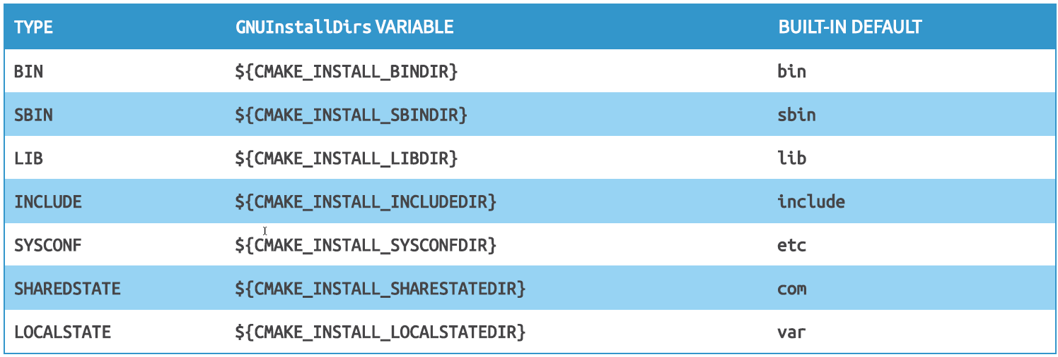
Installation
CMake Installation

Slide 105
CMakePackageConfigHelpers
CMake Installation
Helpers functions for creating config files that can be included by other projects to find and use a package
Adds the configure_package_config_file() and write_basic_package_version_file() commands.
The config file is responsible for ensuring that the required targets are available
typically done by calling find_package()

Slide 106
CMakePackageConfigHelpers
include(CMakePackageConfigHelpers)
write_basic_package_version_file(outFile
[VERSION requiredVersion]
COMPATIBILITY compat
[ARCH_INDEPENDENT] # CMake 3.14)
CMake Installation
Create a version file for a project:
Version file must be in the same directory as the config file
Writes a file for use as <PackageName>ConfigVersion.cmake file to <filename>
<filename> is the output filename, it should be in the build tree. <major.minor.patch> is the version number of the project to be installed.
If no VERSION is given, the PROJECT_VERSION variable is used. If this hasn't been set, it errors out.
If the VERSION is given, the requiredVersion is expected to be in the usual major.minor.patch.tweak form
but only the major part is compulsory
If the VERSION is not given, the PROJECT_VERSION variable is used instead
set by the project() command
The COMPATIBILITY option specifies a strategy for how the compatibility should be determined
AnyNewerVersion: The package version must be equal to or greater than the specified version
ExactVersion: The major, minor, and patch parts of the package version number must be the same as those in the requiredVersion
…
# generate the version file for the config file
write_basic_package_version_file(
"${CMAKE_CURRENT_BINARY_DIR}/cmake/${TARGET_NAME}ConfigVersion.cmake"
VERSION "${version}"
COMPATIBILITY AnyNewerVersion
)

Slide 107
CMakePackageConfigHelpers
include(CMakePackageConfigHelpers)
configure_package_config_file(<input> <output>
INSTALL_DESTINATION <path>
)
CMake Installation
configure_package_config_file
Create a config file for a project
. configure_package_config_file() should be used when creating the <PackageName>Config.cmake or <PackageName>-config.cmake file for installing a project or library.
It helps making the resulting package relocatable by avoiding hardcoded paths in the installed Config.cmake file.
# Create the package config file for the target
configure_package_config_file(
"${CMAKE_CURRENT_SOURCE_DIR}/cmake/Config.cmake.in"
"${CMAKE_CURRENT_BINARY_DIR}/cmake/${TARGET_NAME}Config.cmake"
INSTALL_DESTINATION ${CMAKE_INSTALL_LIBDIR}/cmake/${TARGET_NAME}
)

Slide 108
Config file
CMake Installation
The Config.cmake.in file should have a single line with the text @PACKAGE_INIT@ in addition to the content that is desired
This tag is expanded by the macro configure_package_configure_and serves mainly to locate the root directory of the installation
That variable will be replaced with a block of code which turns set values into relative paths
These values which are new can be referenced by the same name but prepended with a PACKAGE_ prefix.
check_required_components(<PackageName>) should be called at the end of the Config.cmake.in file
This macro checks whether all requested, non-optional components have been found, and if this is not the case, sets the Foo_FOUND variable to FALSE, so that the package is considered to be not found
It does that by testing the Foo_<Component>_FOUND variables for all requested required components
This macro should be called even if the package doesn't provide any components to make sure users are not specifying components erroneously

Slide 109
Build and install interface
CMake Installation
The library interface may change during installation. Use BUILD_INTERFACE and INSTALL_INTERFACE generator expression filters
Relative paths are allowed within the INSTALL_INTERFACE expression and are interpreted as relative to the installation prefix
Relative paths should not be used in BUILD_INTERFACE expressions because they will not be converted to absolute
$<BUILD_INTERFACE:xxx>
Build: expands to xxx
Install: expands to nothing
$<INSTALL_INTERFACE:yyy>
Build: expands to nothing
Install: expands to yyy
include(GNUInstallDirs)
target_include_directories(Foo
PUBLIC
$<BUILD_INTERFACE:${MyProject_BINARY_DIR}/include>
$<BUILD_INTERFACE:${MyProject_SOURCE_DIR}/include>
$<INSTALL_INTERFACE:${CMAKE_INSTALL_INCLUDEDIR}>)

Slide 110
Install a project
CMake Installation
CMake provides a command-line signature to install an already-generated project binary tree
This may be used after building a project to run installation without using the generated build system or the native build tool
The options are:
--install <dir>
Project binary directory to install. This is required and must be first.
--prefix <prefix>
Override the installation prefix, CMAKE_INSTALL_PREFIX
cmake --install <dir> [<options>]

Slide 111
Exercise – Installation
CMake Installation
We are going to install bob
Include GNUInstallDirs and CMakePackageConfigHelpers in bob’s CMakeLists.txt
Set the CMAKE_INSTALL_PREFIX to "${CMAKE_CURRENT_BINARY_DIR}/install“
Install bob as a Target and associate it with an export called bobTargets
Use the install(EXPORT) form to generate and install a CMake file to import bob from the installation tree into another project
Use the NAMESPACE option of the install command
Use write_basic_package_version_file to generate the version file for the config file
Use configure_package_config_file to create the package config file for the target
Use the Config.cmake.in template that is provided for you in bob/cmake folder.
Install the package config and version file
Install bobs public include files
In the target_include_directories command make sure to use build and install interface
Install bob

Slide 112
CMake FINDING THINGS

Slide 113
Finding things
CMake Finding things
CMake provides a variety of features which allow projects to find various things and to make themselves easy to find and be incorporated into other projects
find_...() commands provide the ability to search for specific files, libraries or programs
Config details
<packageName>Config.cmake or <lowercasePackageName>-config.cmake
usually provided as part of the package itself
more closely aligned with the functionality of the various find_...() commands
A Find module
Find<packageName>.cmake
located in CMAKE_MODULE_PATH or a CMake release
typically defined by something unrelated to the package
usually by CMake or by projects themselves
harder to keep up to date as the package evolves over time

Slide 114
Finding things
CMake Finding things
Module and config files typically
define variables and imported targets for the package
provide the location of programs, libraries, flags to be used by consuming targets, ...
Functions and macros can also be defined

Slide 115
Find_package()
CMake Finding things
find_package(packageName
[version [EXACT]]
[QUIET] [REQUIRED]
[[COMPONENTS] component1 [component2...]]
[OPTIONAL_COMPONENTS component3 [component4...]]
[MODULE]
[NO_POLICY_SCOPE])
version indicates that the package must be of the specified version or higher
or match exactly if EXACT is given
A package may be optional → the project can use it if available or work without it otherwise
REQUIRED marks the package as mandatory
CMake halts with an error if an appropriate package can not be found
A typical use for QUIET is to prevent messages for a missing optional package
that developers are less likely to think it is an error

Slide 116
Find_package()
CMake Finding things
find_package(packageName
[version [EXACT]]
[QUIET] [REQUIRED]
[[COMPONENTS] component1 [component2...]]
[OPTIONAL_COMPONENTS component3 [component4...]]
[MODULE]
[NO_POLICY_SCOPE])
When MODULE is not present, the command will first search for a matching module, then if no such module is found it will search instead for a config package
CMAKE_FIND_PACKAGE_PREFER_CONFIG reverses the search preference (CMake 3.15)
Not all packages support components
it is up to the module or config implementation whether or not components are defined
If a package defines components but no components are given to find_package(), it is up to the module or config definition how this is handled

Slide 117
Find_package()
config file = <packageName>Config.cmake or <lowercasePackageName>-config.cmake
version file = <configName>Version.cmake or `<configName>-version.cmake
CMake Finding things
find_package(Qt5 5.9 REQUIRED Gui Widgets Network)

Slide 118
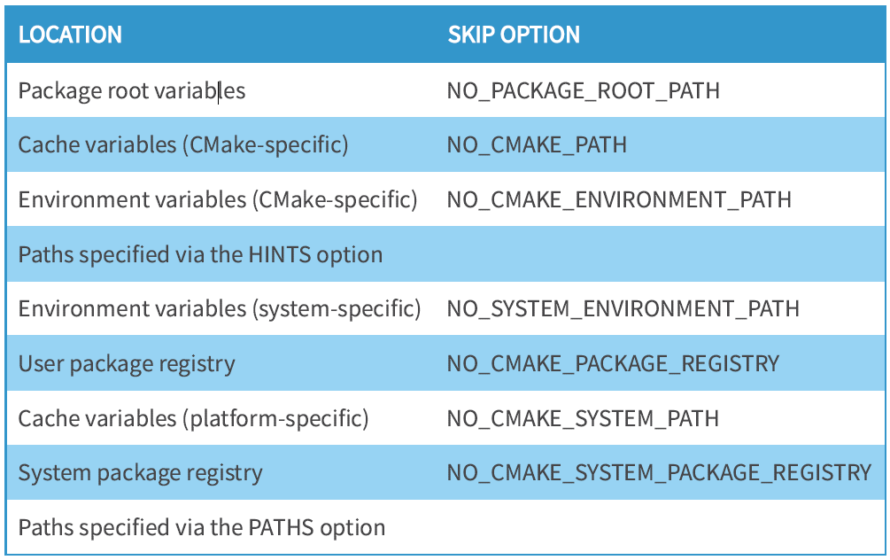
Search order for find_package
CMake Finding things

Slide 119
Finding things
CMake Finding things
PACKAGE ROOT VARIABLES
Each time find_package() is called, it pushes <packageName>_ROOT CMake and environment
variables onto an internally maintained stack of paths
paths are used in exactly the same way as CMAKE_PREFIX_PATH for all find_...() commands
CMake package finding logic is so complicated because it tries really hard to find your dependency in every possible place on any existing platform
Using a dedicated package manager standardizes the above and thus makes it easy to work with all dependencies in a consistent way

Slide 120
Exercise – Finding packages
CMake Generator expressions
Add exercise folder “FindPackage” to your workspace
Instead of using add_subdirectoy call bob by using find_package
Don’t forget to set “bob_ROOT” in order to help find_package find your installed files !
Don’t forget to install bob otherwise you can’t find it !

Slide 121
CMAke GENERATOR EXPRESSIONS

Slide 122
Generator expressions
CMake Generator expressions
Bad
add_executable(hello main.cpp)
if(CMAKE_BUILD_TYPE STREQUAL DEBUG)
target_sources(hello PRIVATE helper_debug.cpp)
else()
target_sources(hello PRIVATE helper_release.cpp)
endif()
Good
add_executable(hello main.cpp
$<IF:$<CONFIG:Debug>,helper_debug.cpp,helper_release.cpp>)

Slide 123
Generator expressions
CMake Generator expressions
$<...>
Provide a way to encode some logic which is not evaluated at configure time. The evaluation is instead delayed until the generation phase when the project files are being written.
Perform conditional logic
Can provide different content based on whether a build or an install is being performed
Output strings providing information about various aspects of the build like directories, names of things, platform details, and more...

Slide 124
Generator expressions
CMake Generator expressions
$<1:...>
$<0:...>
The result of the expression
– for $<1:... >, the ... part
– for $<0:... >, an empty string
Anything other than 0 or 1 for a conditional expression (i.e. True/False) is rejected by CMake with a fatal error.

Slide 125
Generator expressions
CMake Generator expressions
$<BOOL:...>
Evaluates the ... content in the same way that the if() command evaluates a boolean constant
it understands all the usual special strings like OFF, NO, FALSE, ...
A very common pattern is to use it to wrap the evaluation of a variable that is expected to hold a boolean value, but which might not be restricted to 0 or 1.

Slide 126
Generator expressions
CMake Generator expressions
$<AND:expr[,expr...]>
$<OR:expr[,expr...]>
$<NOT:expr>
Each expr is expected to evaluate to either 1 or 0
• The AND and OR expressions can take any number of comma-separated arguments
• NOT accepts only a single expression
Because AND, OR, and NOT require that their expressions evaluate to only 0 or
1, consider wrapping those expressions in a $<BOOL:... > to force more
tolerant logic of what is considered a true or false expression.

Slide 127
Generator expressions
CMake Generator expressions
$<STREQUAL:string1,string2>
$<EQUAL:number1,number2>
$<VERSION_EQUAL:version1,version2>
$<VERSION_GREATER:version1,version2>
$<VERSION_LESS:version1,version2>
The above evaluate to 1 if the respective condition is satisfied, or 0 otherwise

Slide 128
Generator expressions
CMake Generator expressions
$<CONFIG:arg>
Evaluates to 1 if arg corresponds to the build type actually being built and 0 for all other build types
Never use CMAKE_BUILD_TYPE in if()
CMAKE >= 3.8
add_executable(MyApp src1.cpp src2.cpp)
target_link_libraries(MyApp PRIVATE
$<IF:$<CONFIG:Debug>,CheckedAlgo,FastAlgo>)

Slide 129
Generator expressions
CMake Generator expressions
Obtaining the value of the named property from the specified target
$<TARGET_PROPERTY:target,property>
Obtaining the property from the target on which the generator expression is being used
$<TARGET_PROPERTY:property>
TARGET_PROPERTY is a very generic expression type
not always the best way to obtain information about a target

Slide 130
Target Details
CMake Generator expressions
$<TARGET_FILE:target>
Yields the absolute path and file name of the target’s binary
Includes any file prefix and suffix if relevant for the platform
e.g .exe, .dylib, version details for shared libraries on Unix-based platforms
$<TARGET_FILE_NAME:target>
Same as TARGET_FILE but without the path
$<TARGET_FILE_DIR:target>
Same as TARGET_FILE but without the file name
The most robust way to obtain the directory in which the final executable or library is built
Value is different for different build configurations when using a multi-configuration generator

Slide 131
CONAN

Slide 132
Pure CMake: Dependencies the Wrong Way
Conan
Process
Build each repository in isolation, generate and install its binaries along with a CMake config file
For each project that has dependencies, use find_package() to load the config file and use the library
Problems
Updating a program implies recompiling its package and then every one of its dependers manually
It doesn't scale (many levels of dependencies, many configurations, ...)
What about supporting different versions?
– Release, Debug, RelWithDebInfo, ...
– different compilers (gcc, clang, ...), compiler versions, C++ libraries (libc++ vs libstdc++)
– different runtime libraries
– different package configurations (no exceptions, shared lib, ...)

Slide 133
What we want ?
Conan
One build process builds the project and all dependencies
Only required dependencies are being rebuilt
– reuse of prebuilt binaries if available and up-to-date
No need to manually download, build and install the dependencies
Possibility to use our own versions of dependencies (ZLib, Boost, etc) instead of using system versions

Slide 134
Conan
Conan
Conan is a MIT-licensed, Open-Source package and dependency manager for C and C++ development,
allowing development teams to easily and efficiently manage their packages and dependencies across platforms and build systems
It is specifically designed and optimized for accelerating the development and Continuous Integration of C and C++ projects
Decentralized package manager with a client-server Architecture
The servers are just a package storage
they do not build nor create the packages
The packages are created by the client
packaging of prebuilt binaries
building from sources if needed
Portable to any platform supporting Python
Works with any build system
Uses Python as its scripting language
Easy hosting in a cloud or on a local server
Notes:
Conan is a decentralized package manager with a client-server architecture. This means that clients can fetch packages from, as well as upload packages to, different servers (“remotes”), similar to the “git” push-pull model to/from git remotes.
At a high level, the servers are just storing packages. They do not build nor create the packages. The packages are created by the client, and if binaries are built from sources, that compilation is also done by the client application.

Slide 135
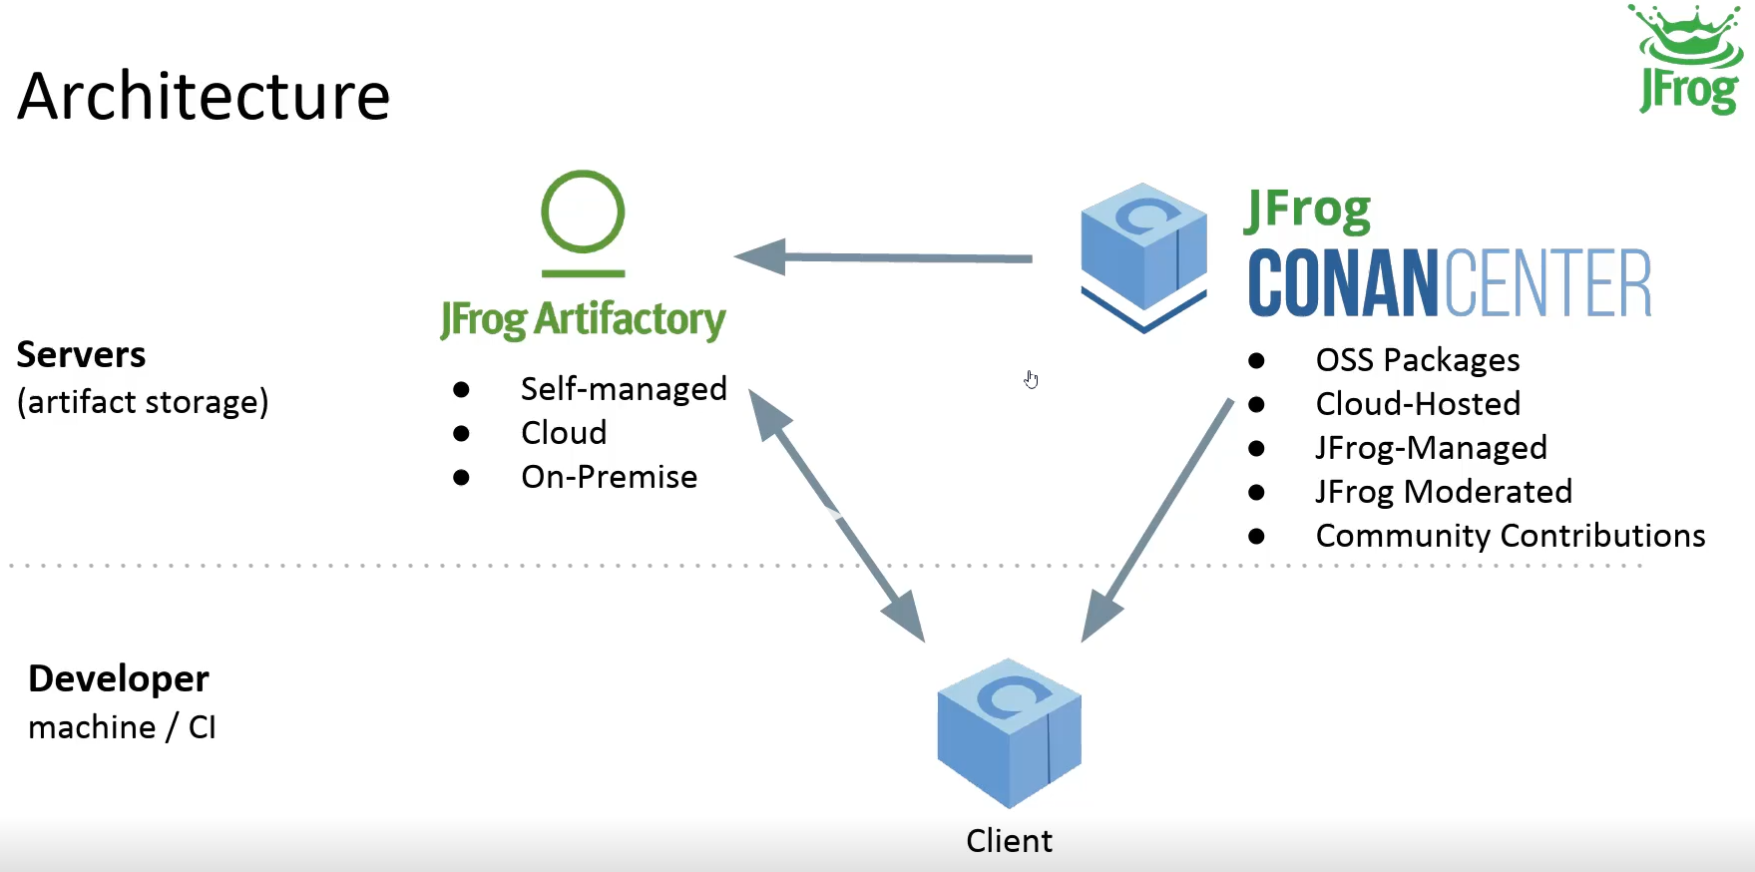
Conan - Architecture
Conan
Notes:
The different applications in the image above are:
The Conan client: this is a console/terminal command-line application, containing the heavy logic for package creation and consumption. Conan client has a local cache for package storage, and so it allows you to fully create and test packages offline. You can also work offline as long as no new packages are needed from remote servers.
JFrog Artifactory Community Edition (CE) is the recommended Conan server to host your own packages privately under your control. It is a free community edition of JFrog Artifactory for Conan packages, including a WebUI, multiple auth protocols (LDAP), Virtual and Remote repositories to create advanced topologies, a Rest API, and generic repositories to host any artifact.
The conan_server is a small server distributed together with the Conan client. It is a simple open-source implementation and provides basic functionality, but no WebUI or other advanced features.
ConanCenter is a central public repository where the community contributes packages for popular open-source libraries like Boost, Zlib, OpenSSL, Poco, etc.

Slide 136
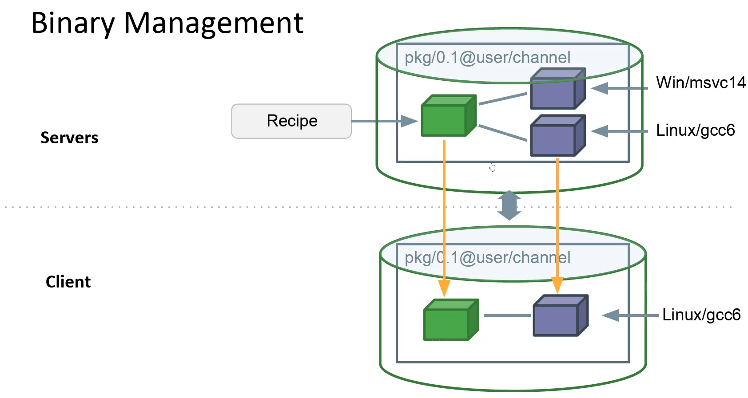
Conan – Binary Management
Conan
Recipe Reference
Package binaries
Notes:
One of the most powerful features of Conan is that it can create and manage pre-compiled binaries for any possible platform and configuration. By using pre-compiled binaries and avoiding repeated builds from source, it saves significant time for developers and Continuous Integration servers, while also improving the reproducibility and traceability of artifacts.
A package is defined by a “conanfile.py”. This is a file that defines the package’s dependencies, sources, how to build the binaries from sources, etc. One package “conanfile.py” recipe can generate any arbitrary number of binaries, one for each different platform and configuration: operating system, architecture, compiler, build type, etc. These binaries can be created and uploaded to a server with the same commands in all platforms, having a single source of truth for all packages and not requiring a different solution for every different operating system.
Installation of packages from servers is also very efficient. Only the necessary binaries for the current platform and configuration are downloaded, not all of them. If the compatible binary is not available, the package can be built from sources in the client too.

Slide 137
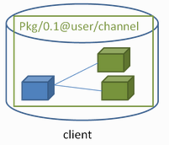
Recipe reference
Conan
package_name/package_version@owner/channel
Recipe reference has a form of a string and is an identifier of the package in Conan
One recipe reference can represent any number of separate physical binaries
each binary being the result of each unique build of the library or application in the package
PACKAGE_NAME
Usually project/library name
PACKAGE_VERSION
Any string
OWNER
Owner of the package version
Namespace that allows different users to have their own packages for the same library with the same name
CHANNEL
Allows different packages for the same library
Usually denote the maturity of a package ("stable", "testing")

Slide 138
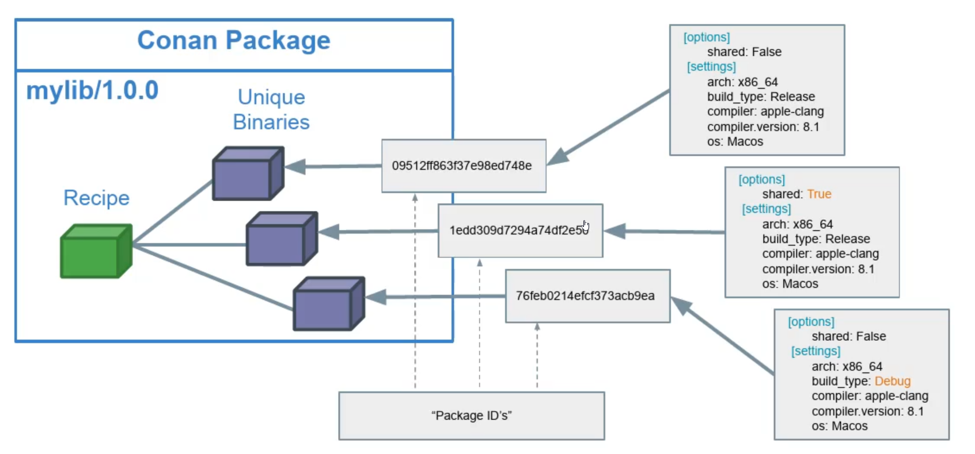
Conan Packaging
Conan
Conan hashes together "options" and "settings" to calculate a unique value for each binary package
Notes:
Conan creates a unique binary package for every unique build configuration
– OS and architecture
– compiler type and its version
– build settings (i.e. Debug, Release)
– package options
Each unique build configuration is hashed together to produce a unique identifier called a Package ID.
All of the binary packages can be uploaded to the server for storage.
Clients are typically interested in only one or at most a few of those at a time

Slide 139
Conan user
Conan
Authenticates against a remote with user and pass, caching the auth token
conan user <windows_user> -r ra6-test –p
conan user <windows_user> -r conancenter –p

Slide 140
Conan search
Conan
Searches package recipes and binaries in the local cache or a remote
Unless a remote is specified only the local cache is searched
List all packages in the local cache
Search for a specific package in the local cache
Searching for a package on remote
conan search
conan search gtest*
conan search -r conancenter gtest*
Notes:
By default Conan only searches in local cache. This is different from other
package managers that oen search remotes by default.

Slide 141
Conan inspect
Conan
Displays conanfile attributes, like name, version, and options
Works locally, in local cache and remote
Example
conan inspect gtest/1.10.0@
conan inspect -r conancenter gtest/1.10.0@

Slide 142
Exercise - conan search/inspect
Conan
All of the following will be done in a terminal in VS Code
Login to conan using conan user
Add conancenter as a remote via
Search on the remote for gtest and check which versions are available
Install gtest version 1.10.0
Inspect the gtest 1.10.0 package locally
Inspect the gtest package 1.8.1 from conancenter
conan remote add conancenter https://center.conan.io
conan install gtest/1.10.0@ -r conancenter -s arch_build=x86 -s os_build=Windows
Notes:
By default Conan only searches in local cache. This is different from other
package managers that oen search remotes by default.

Slide 143
CONAN PACKAGE BASICS

Slide 144
Package Creation
Conan
A package is defined by a “conanfile.py” = recipe
defines the package’s dependencies, sources, how to build the binaries from sources, etc.
one recipe can generate any arbitrary number of binaries, one for each different platform and configuration: operating system, architecture, compiler, build type, etc.

Slide 145
Conanfile.py
from conans import ConanFile, CMake
class HelloConan(ConanFile):
name = "hello"
version = "0.1"
license = "<Put the package license here>"
url = "<Package recipe repository url here, for issues about the package>"
description = "<Description of hello here>"
settings = "os", "compiler", "build_type", "arch"
options = {"shared": [True, False]}
default_options = {"shared": False}
generators = „CMakeToolchain"
exports_sources = "src/*"
def build(self):
cmake = CMake(self)
cmake.configure(source_folder="src")
cmake.build()
# Explicit way:
# self.run('cmake "%s/src" %s' % (self.source_folder, cmake.command_line))
# self.run("cmake --build . %s" % cmake.build_config)
def package(self):
self.copy("*.h", dst="include", src="src")
self.copy("*.lib", dst="lib", keep_path=False)
self.copy("*.dll", dst="bin", keep_path=False)
self.copy("*.dylib*", dst="lib", keep_path=False)
self.copy("*.so", dst="lib", keep_path=False)
self.copy("*.a", dst="lib", keep_path=False)
def package_info(self):
self.cpp_info.libs = ["hello"]
Conan

Slide 146
Conanfile.py
from conans import ConanFile, CMake
class HelloConan(ConanFile):
name = "hello"
version = "0.1"
license = "<Put the package license here>"
url = "<Package recipe repository url here, for issues about the package>"
description = "<Description of hello here>"
settings = "os", "compiler", "build_type", "arch"
options = {"shared": [True, False]}
default_options = {"shared": False}
generators = "cmake_paths"
exports_sources = "src/*"
Conan
The binary configuration is composed by settings and options. When something changes in the configuration, the resulting binary built and packaged will be different
settings are project wide configuration, that cannot be defaulted in recipes, like the OS or the architecture
options are package specific configuration and can be defaulted in recipes

Slide 147
Conan settings
from conans import ConanFile, CMake
class HelloConan(ConanFile):
settings = "os", "compiler", "build_type", "arch"
Conan
Project-wide and common to all the dependencies
allows them to link together without issues with the project being built
Provided by the environment
Cannot be defaulted in the project's recipe
Typical settings
OS (build and host)
architecture (build and host)
build type
compiler data
compiler kind (gcc, clang, intel, msvc, ...)
compiler version
C++ standard library
C++ standard version

Slide 148
Conan settings
from conans import ConanFile, CMake
class HelloConan(ConanFile):
settings = "os", "compiler", "build_type", "arch"
Conan
All settings are validated against ${CONAN_USER_HOME}/settings.yml file that contains the information about all valid setting types and their values.
User is allowed to add or remove any entry from this list to support custom scenarios
Current settings can be overridden from a command line to amend the build configuration
--settings or -s command line option
conan install .. -s build_type=Debug
Affect the generation of the package unique ID
Have to be defined in the conanfile
can not have a default value listed in the conanfile, as it would not make sense

Slide 149
Exercise – Conan settings
Conan
Navigate to C:\Users\<NT-User>\.conan\ and open settings.yml
Inspect the settings.yml and get an impression what settings exist

Slide 150
Conan options
from conans import ConanFile, CMake
class HelloConan(ConanFile):
options = {"shared": [True, False]}
Conan
Package-specific configuration
Each dependency can provide different set of options to fulfill their configuration needs
Declare traits which will affect only one reference
unlike the settings that are typically the same for all the recipes in a Conan graph
Default option values provided in the recipe file can be overridden by the user
Typical options (e.g. shared, fPIC, lto, active FPU)
Command line override:
conan install .. -o gtest:shared=True
All the options with their values are encoded as a part of the package ID

Slide 151
Conan profiles
Conan
~/.conan/profiles/default
Contain settings, options, environment variables
If not specified an automatically generated default profile is used
Custom profiles possible and encouraged
Plain text files
Easy to share between teams and CI services
Profile files do not have any file extension
Profile files are by default located in the ~/${CONAN_USER_HOME}/profiles
directory but can be also distributed anywhere in a project
[settings]
os=Linux
os_build=Linux
arch=x86_64
arch_build=x86_64
compiler=gcc
compiler.version=10
compiler.libcxx=libstdc++
build_type=Release
[options]
[env]

Slide 152
Exercise – Conan profile
Conan
Navigate to C:\Users\<NT-User>\.conan\profiles and open default
Inspect the default profile and get an impression how it looks like

Slide 153
CONAN PACKAGE CREATION

Slide 154
Exercise – conan new
Conan
Let‘s create a simple recipe ☺
conan new creates a new package recipe template with a ‘conanfile.py’ and optionally, ‘test_package’ testing files.
In your terminal navigate to exercise „Conan_New“
Create a conanfile.py by using „conan new mypackage/1.0@cmaketraining/testing”
Create a conanfile.py by using „conan new mypackage/1.0@cmaketraining/testing --template=cmake_lib
Play around what conan new can help you with by checking arguments from the documentation https://docs.conan.io/en/latest/reference/commands/creator/new.html
Check what is the content of the conanfile.py. There will be some lines generated that we will explain soon.

Slide 155
Recipe options
from conans import ConanFile, CMake
class HelloConan(ConanFile):
name = "hello"
version = "0.1"
license = "<Put the package license here>"
url = "<Package recipe repository url here, for issues about the package>"
description = "<Description of hello here>"
settings = "os", "compiler", "build_type", "arch"
options = {"shared": [True, False]}
default_options = {"shared": False}
generators = “CMakeToolchain"
exports_sources = "src/*“
Conan
exports_source
The exports_sources attribute defines which sources are exported together with the recipe, these sources become part of the package recipe
generators
Generators specify which is the output of the install command in your project folder. By default, a conanbuildinfo.txt file is generated, but you can specify different generators and even use more than one.

Slide 156
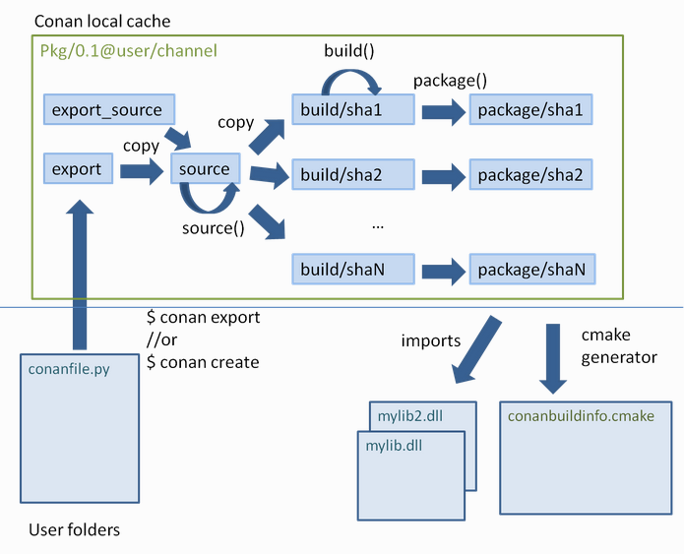
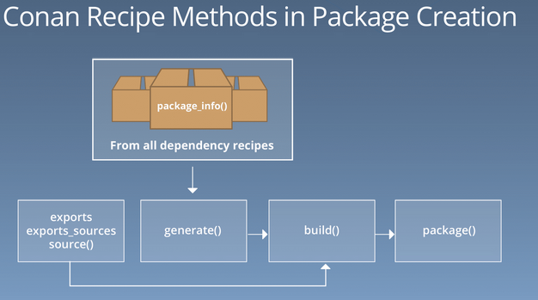
Conan create
Conan
Builds a binary package for a recipe (conanfile.py)
conan create . demo/testing

Slide 157
Package Creation
Conan
Each package recipe contains five important folders in the local cache:
export: The folder in which the package recipe is stored
export_source: The folder in which code copied with the recipe exports_sources attribute is stored
source: The folder in which the source code for building from sources is stored
build: The folder in which the actual compilation of sources is done. There will typically be one subfolder for each different binary configuration
package: The folder in which the final package artifacts are stored. There will be one subfolder for each different binary configuration
The source and build folders only exist when the packages have been built from sources.

Slide 158
Package creation
Conan
def layout(self):
cmake_layout(self)
def generate(self):
tc = CMakeToolchain(self)
tc.generate()
def build(self):
cmake = CMake(self)
cmake.configure()
cmake.build()
def package(self):
cmake = CMake(self)
cmake.install()
def package_info(self):
self.cpp_info.libs = ["bob"]

Slide 159
Creating packages → layout ()
Conan
With the layout method you can specify where the files corresponding to your folders lie, such as
Source folder
Build folder
Generator folder
Package folder
…
For CMake projects use cmake_layout(self)
def layout(self):
cmake_layout(self)

Slide 160
Creating packages → generate ()
Conan
Instead of declaring the attributes you can also implement the corresponding method in the conanfile
The purpose of generate() is to prepare the build, generating the necessary files
These files would typically be:
Files containing information to locate the dependencies, as xxxx-config.cmake CMake config scripts
Environment activation scripts, that define all the necessary environment variables necessary for the build.
Toolchain files, like conan_toolchain.cmake, that contains a mapping between the current Conan settings and options, and the build system specific syntax.
General purpose build information, as a conanbuild.conf file that could contain information like the CMake generator or CMake toolchain file to be used in the build() method.
def generate(self):
tc = CMakeToolchain(self)
tc.generate()
generators = “CMakeToolchain"
=

Slide 161
Generators CMakeToolchain
Conan
The CMakeToolchain is the toolchain generator for Cmake
It translates the current package configuration, settings, and options, into CMake toolchain syntax
It will generate the following files when doing a conan install or when building the package in the cache
conan_toolchain.cmake file: Translates the current package configuration, settings, and options intoCMake toolchain syntax
conanbuild.conf: Contains arguments to the command line CMake() helper used in the recipe build() method (i.e. CMake generator)
conanvcvars.bat: for MSVC compilers and CMake generators like Ninja or NMake
CMakePresets.json: Conan creates a default configure preset with the information:
The generator to be used.
The path to the conan_toolchain.cmake
Some cache variables corresponding to the specified settings cannot work if specified in the toolchain.
This file will be generated at the conanfile.generators_folder, If you want your IDE (Visual Studio, Visual Studio Code, CLion…) to leverage this file you should create a symlink or copy the generated file to the folder containing the CMakeLists.txt file.

Slide 162
Generators CMakeDeps
Conan
Multi-configuration generator
Generates XXX-config.cmake or FindXXX.cmake files per dependency together with other necessary .cmake files like version, flags, and directory data or configuration
Provides CMake's find_package() support for packages that
do not use CMake at all
do not provide installation support
generate broken CMake configuration scripts
It is encouraged to depend on Conan generated files rather than trying to use packages' original files (if provided)
def generate(self):
deps = CMakeDeps(self)
# By default, 'deps.configuration' will be 'self.settings.build_type'
if self.options.profile:
# Assuming the current project 'CMakeLists.txt' defines the 'Profile' configuration
deps.configuration = "Profile"
deps.generate()

Slide 163
Creating packages → build ()
Conan
Used to build the source code of the recipe using the desired commands
Runs command line tools to invoke build system or any of the build helpers provided with Conan
def build(self):
cmake = CMake(self)
cmake.configure()
cmake.build()
def build(self):
cmake = CMake(self)
self.run("cmake . %s" % (cmake.command_line))
self.run("cmake --build . %s" % cmake.build_config)

Slide 164
Creating packages → package()
Conan
The actual creation of the package, once that it is built, is done in the package() method
Using the self.copy() method, artifacts are copied from the build folder to the package folder
If you implemented installation step in Cmake you can you cmake.install() command
def package(self):
cmake = CMake(self)
cmake.install()
def package(self):
self.copy("*.h", dst="include", src="src")
self.copy("*.lib", dst="lib", keep_path=False)
self.copy("*.dll", dst="bin", keep_path=False)
self.copy("*.dylib*", dst="lib", keep_path=False)
self.copy("*.so", dst="lib", keep_path=False)
self.copy("*.a", dst="lib", keep_path=False)

Slide 165
Creating packages → package()
Conan
self.copy(pattern, dst="", src="", keep_path=True, symlinks=None, excludes=None, ignore_case=True)
pattern (Required): A pattern following fnmatch syntax of the files you want to copy, from the build to the package folders. Typically something like *.lib or *.h.
src (Optional, Defaulted to ""): The folder where you want to search the files in the build folder. If you know that your libraries when you build your package will be in build/lib, you will typically use build/lib in this parameter. Leaving it empty means the root build folder in local cache.
dst (Optional, Defaulted to ""): Destination folder in the package. They will typically be include for headers, lib for libraries and so on, though you can use any convention you like. Leaving it empty means the root package folder in local cache.
keep_path (Optional, Defaulted to True): Means if you want to keep the relative path when you copy the files from the src folder to the dst one. Typically headers are packaged with relative path.

Slide 166
Exercise – conan create
Conan
We want to create a „bob“ package:
Set up the conanfile.py in ConanCreate/src/bob
Make sure that you can build the package from sources and specify the corresponding file in export_sources
Use CMakeToolchain generator
Create a bob package via „conan create . bob/testing“
Create one package with Build_type „Debug“ and one for „Release“
Bob_default and bob_release profiles can be found in the exercise folder. Just copy them to the correct location

Slide 167
CONAN INSTALL

Slide 168
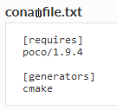
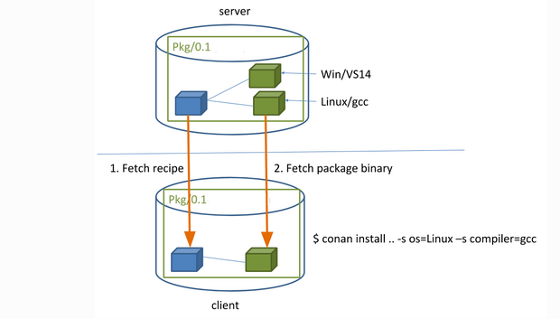
Conan - Installation
Conan
Conan install .
When the conan install command runs, settings specified on the command line or taken from the defaults in <userhome>/.conan/profiles/default file are applied
For example, the command conan install .. --settings os="Linux" --settings compiler="gcc", performs these steps:
Checks if the package recipe (for poco/1.9.4 package) exists in the local cache. If we are just starting, the cache is empty.
Looks for the package recipe in the defined remotes. Conan comes with conancenter remote as the default, but can be changed.
If the recipe exists, the Conan client fetches and stores it in your local Conan cache.
With the package recipe and the input settings (Linux, GCC), Conan looks for the corresponding binary in the local cache.
As the binary is not found in the cache, Conan looks for it in the remote and fetches it.
Finally, it generates an appropriate file for the build system specified in the [generators] section.

Slide 169
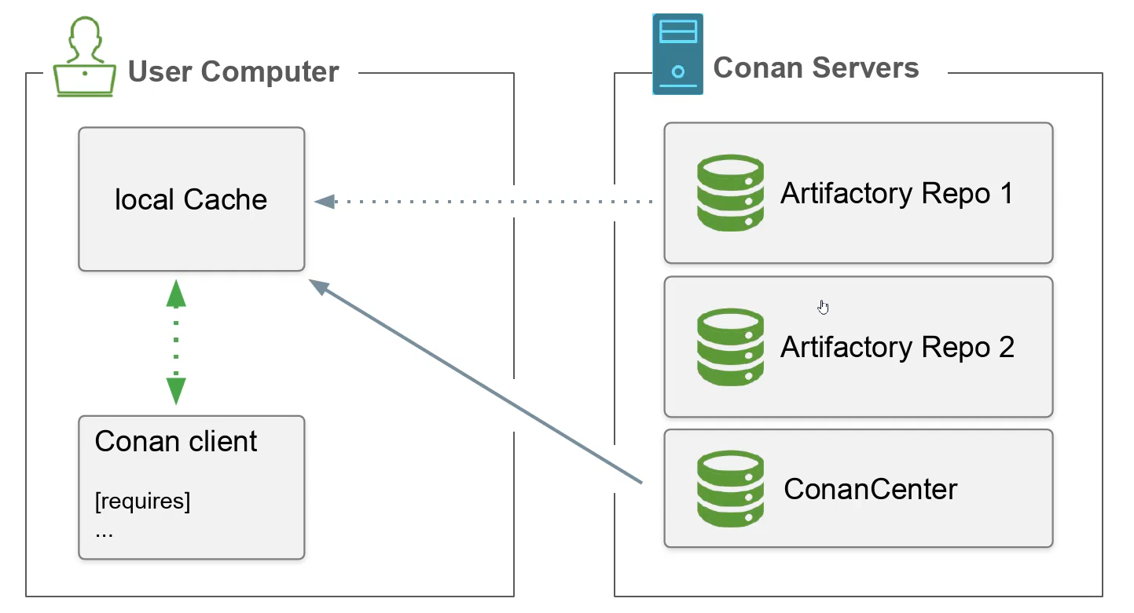
Conan - Installation
Conan
It looks for each dependencies in the local cache first. After that it checks the remotes in the order of the index number
By default conan center is the only remote in the index position zero → you can change the order to search in your private repositories first
Notes:
All package related data lands in the Conan Local Cache
Typically located in the ~/${CONAN_USER_HOME}/data directory
Conan Local Cache helps in sharing the same dependencies between various
projects and repositories on the same PC

Slide 170
Conan install
Conan
Installs the requirements specified in a recipe (conanfile.py or conanfile.txt).
It can also be used to install a concrete package specifying a reference
If any requirement is not found in the local cache, it will retrieve the recipe from a remote, looking for it sequentially in the configured remotes
By default Conan will always look for prebuilt binary to use and fail if not found
Conan does not silently build from sources (it can be built from sources using the ‘–build’ option)
When the package is installed, Conan will write the files for the specified generators
Helps to maintain a fast CI pipeline
build once use forever
exactly the same binary artifacts always used for all dependents
Build the dependency from its sources once and upload the resulting binary package to the Conan Artifactory for future CI builds

Slide 171
Conan install – Build options
Conan
Build options
--build: Always build everything from source. Produces a clean re-build of all packages. and transitively dependent packages
--build=missing: Conan will try to build packages from source whose binary package was not found in the requested configuration on any of the active remotes or the cache.
--build=cascade: Build packages that have at least one dependency being built from source
--build=never: Never build from sources. Fails when a binary package is not available
--build=outdated: Only build packages without binaries or if they were built for an older version of the recipe

Slide 172

Exercise – Finding packages with Conan
Conan
We want Alice to find bob with help of Conan
Set up a conanfile.py for Alice and tell her to require bob/1.0@bob/testing
Make sure to use CMakeToolchain and CMakeDeps generator
Run conan install to install all dependencies for alice, use the same profile as for bob
You need to tell Cmake to find your conan_toolchain.cmake in order to work correctly

Slide 173
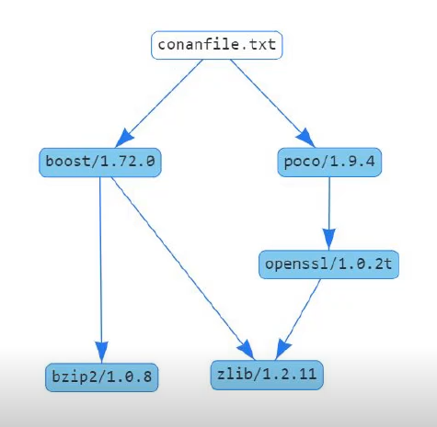
Exercise - Conan info
Conan
Plot a dependency graph for Alice
Conan info . --graph=file.html

Slide 174
Conan remove
Conan
Removes packages or binaries matching pattern from local cache or remote
Remove all data from the local cache
conan remove '*'
Remove prebuilt binary artifacts for all versions of gtest
conan remove gtest/* --packages
Remove the temporary build folders from all the packages in the local cache
conan remove '*' --builds --force
Remove the recipe and the binary packages from a specific remote
conan remove gtest/1.10.0@ -r myremote

Slide 175
Exercise – Conan remove
Conan
Remove Gtest Version 1.10.1 from your local cache

